Slide 1
Exploratory Data Analysis and Building K-Mean Clustering Model
Anshu Anamika

Slide 2
Customer data set
Rows,Colums: 2627, 10
Colums: 'ID', 'Gender', 'Ever_Married', 'Age', 'Graduated', 'Profession', 'Work_Experience', 'Spending_Score', 'Family_Size', 'Var_1’
All Categorical columns except : 'Age', 'Work_Experience', 'Family_Size’
6 columns have missing values

Slide 3
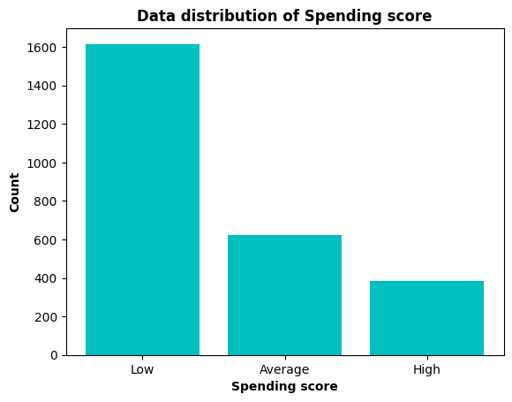
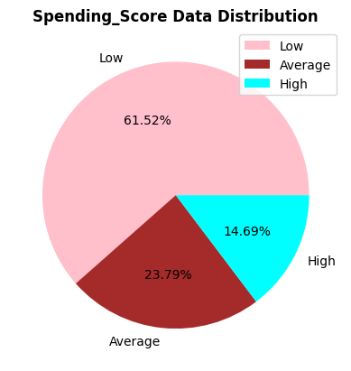

Slide 4
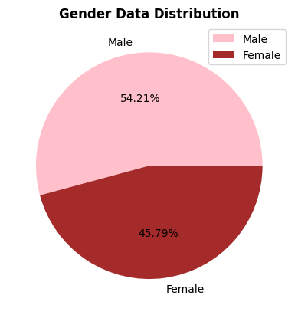
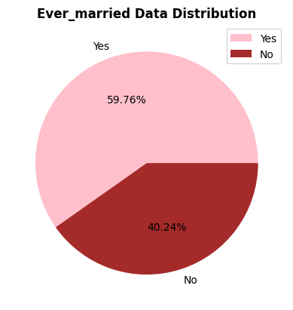
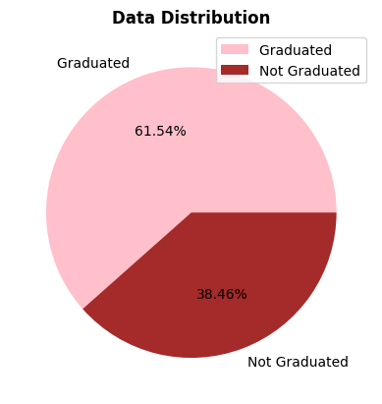

Slide 5
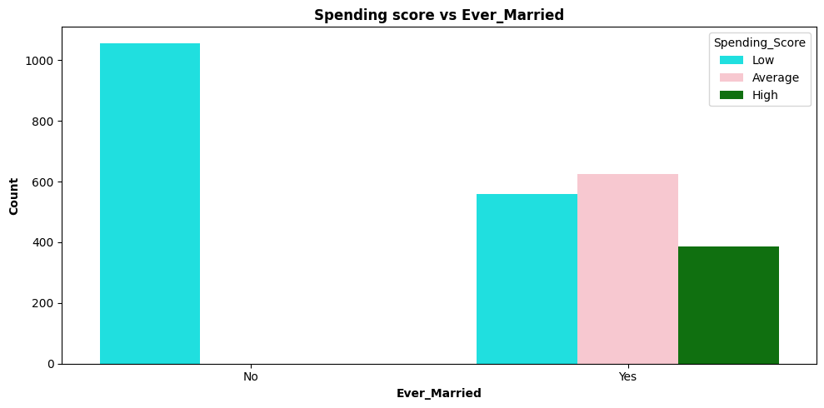
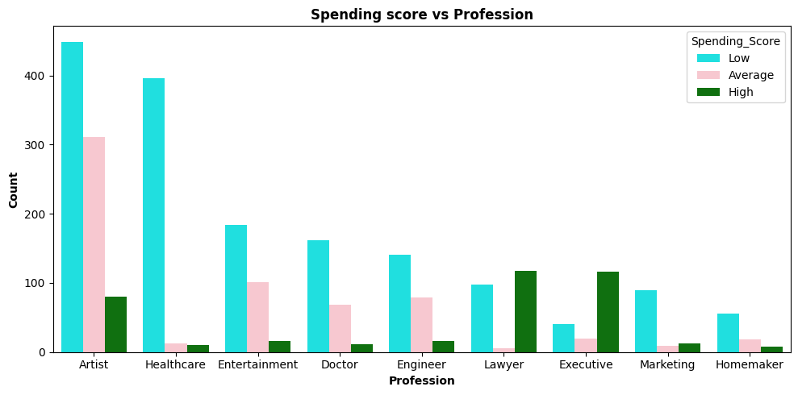

Slide 6
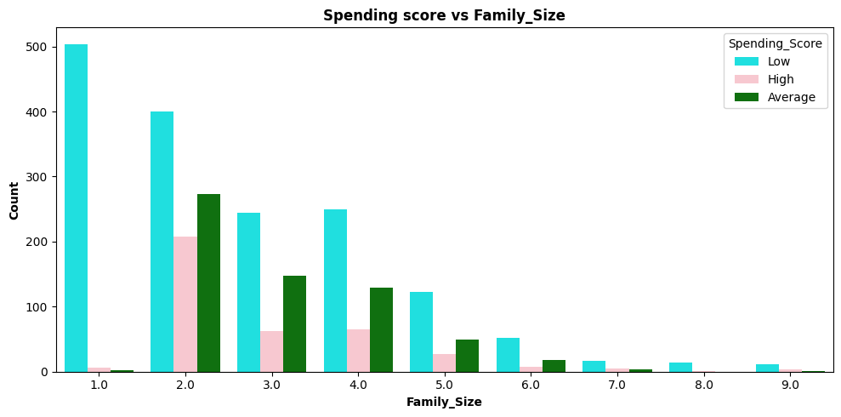
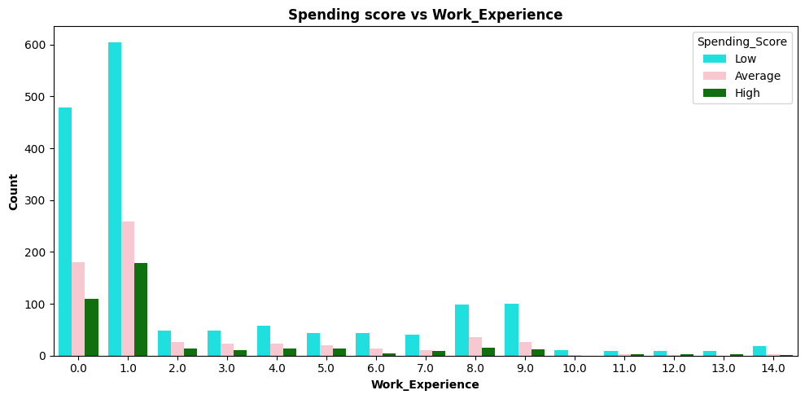

Slide 7
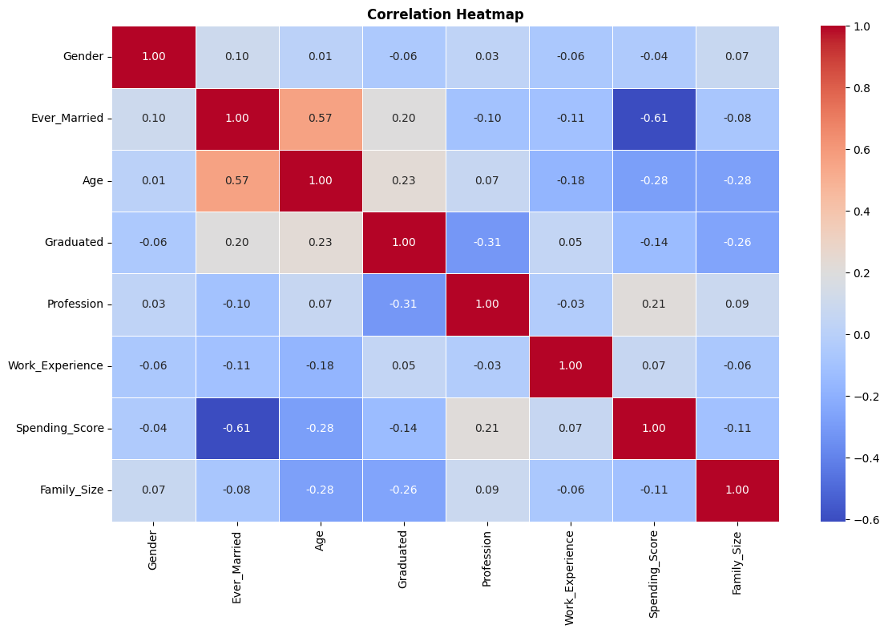

Slide 8
Preprocessing
Filled missing values: Categorical columns- Mode, Numeric column-median
Convert categories into numerical categories by Label encoder
Robust scaler for scaling

Slide 9
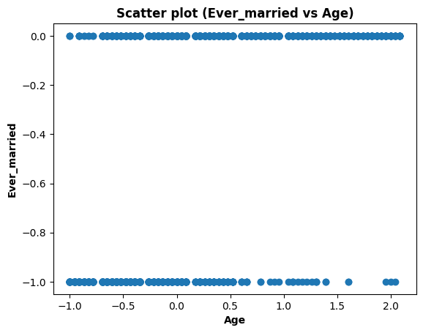
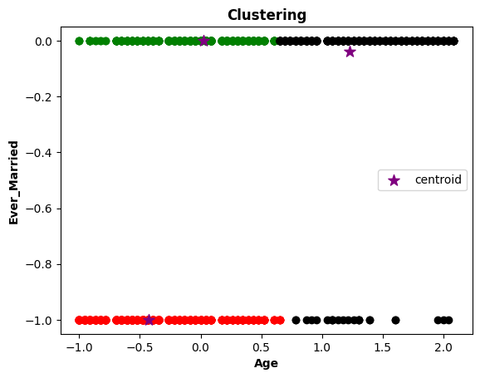
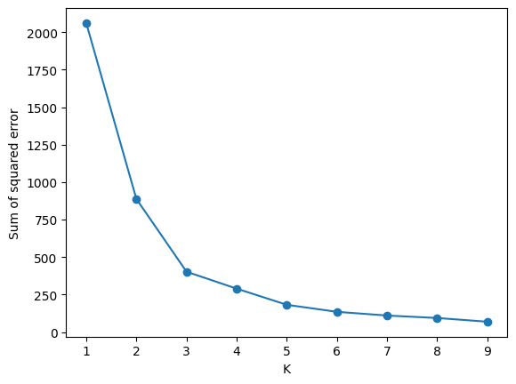
K-mean clustering (k=3) for Ever_Married vs Age

Slide 10
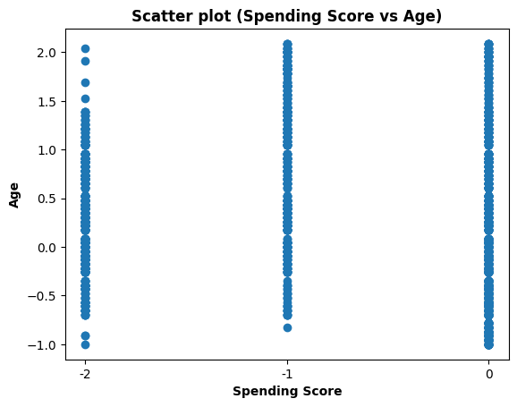
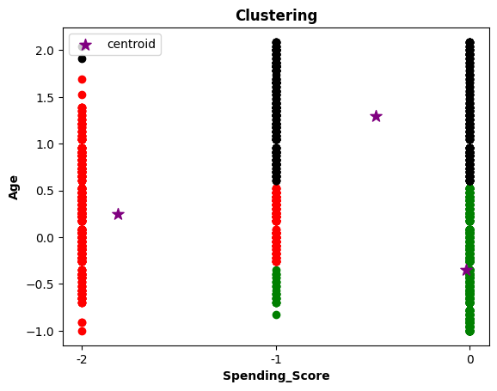
K-mean clustering (k=3) for Spending Score, Age

Slide 11
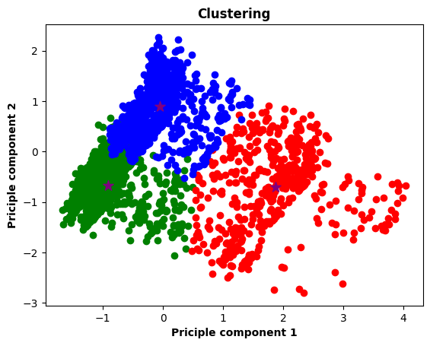
K mean (k=3) clustering including all features with PCA

Slide 12
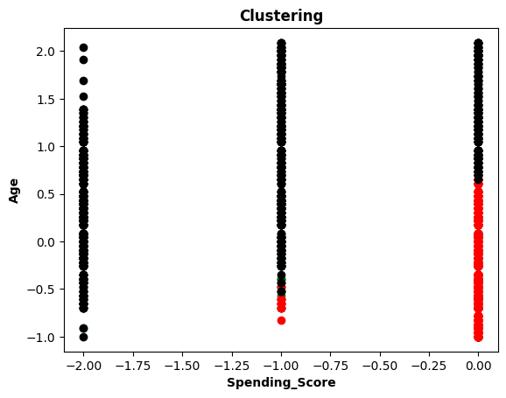
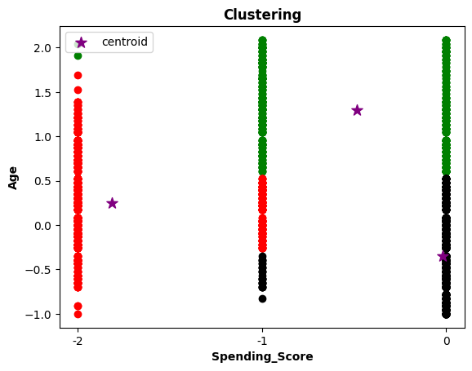
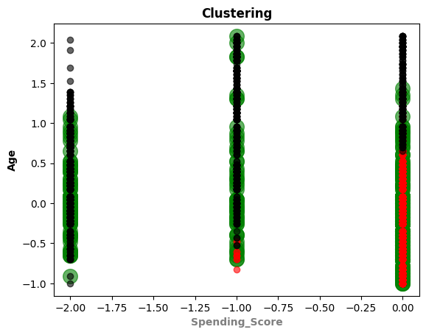
K mean clustering including all features without PCA

Slide 13
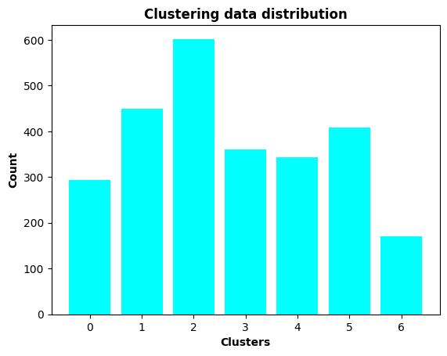
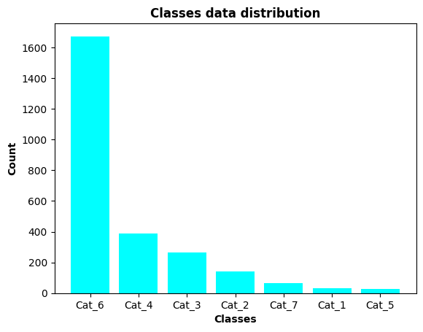
Comparison of classes vs clusters

